Slide 1
ELECTRIC POTENTIAL

Slide 2

Suppose we wish to move a point charge Q from point A to point B in an electric field E.
work done in displacing the charge by dL is
The negative sign indicates that the work is being done by an external agent.
Thus the total work done, or the potential energy required, in moving Q from A to B is

Slide 3



This quantity, denoted by VAB, is known as the potential difference between points A and B. Thus
The Electric potential at any point is the potential difference between that point and a chosen point in which the potential is zero.
By assuming zero potential at infinity, the potential at a distance r from the point charge is the work done per unit charge by an external agent in transferring a test charge from infinity to that point.

Slide 4
Example
Two point charges - 4 µC and 5 µC are located at ( 2 , - 1 , 3) and (0, 4, - 2 ) , respectively.
Find the potential at (1, 0, 1) assuming zero potential at infinity.

Slide 5


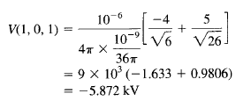
Solution

Slide 6

ELECTRIC FIELD & ELECTRIC POTENTIAL
The electric field intensity is the gradient of electric potential V.
The negative sign shows that the direction of E is opposite to the direction in which V increases; E is directed from higher to lower levels of V.

Slide 7
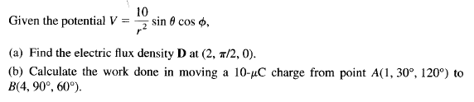
Example

Slide 8
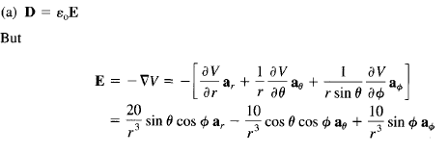
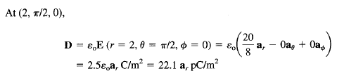
Solution

Slide 9
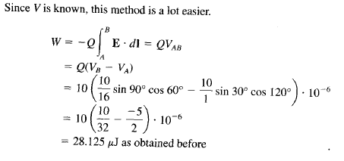

Slide 10
END

